Slide 1
Data Analysis (II) :
Exploratory Data Analysis
Mohamed Albirair, MBBS, MPH, PhD
Jan 2026

Slide 2
1 | Brief Revision

Slide 3
Types of Data in
Quantitative Research
Categorical
Nominal
(gender, marital status, race)
Ordinal
(severity scale, good/better/best)
Numerical
Discrete
(number of children in a family)
Continuous
(height, weight, cholesterol level)

Slide 4


Types of Data Analysis by
Purpose of the Analysis
Descriptive/ Comparative
Inferential
Describe summaries, patterns and explore associations in the sample only, with no further interpretation
Explore relationships or make judgements on the source popoulation based on the sample

Slide 5
Types of Data vs. Types of Analysis
 | Categorical | Numerical
Descriptive | ? | ?
Comparative | ? | ?
Inferential | ? | ?

Slide 6


Types of Data Analysis by
Number of Variables
Univariate
Bivariate
Multivariate
Only one variable.
Find summaries.
e.g., age
Describe/explore relationship between 2 variables
e.g., relationship between age and weight
Describe/explore relationship between 3 variables or more
e.g., relationship between age and weight stratified by sex (and/or race… etc.)

Slide 7


Indicators/Measures
Proportion
Ratio
Rate
Univariate
Bivariate
Time

Slide 8













Population
Sample
Sampling
Inference

Slide 9


Population
Sample
Sampling
Mean, median, standard deviation,
Odds ratio… etc.
Inference
Descriptive/ Comparative analysis
Notes:
Sample of 50, compare the weights of boys and girls

Slide 10

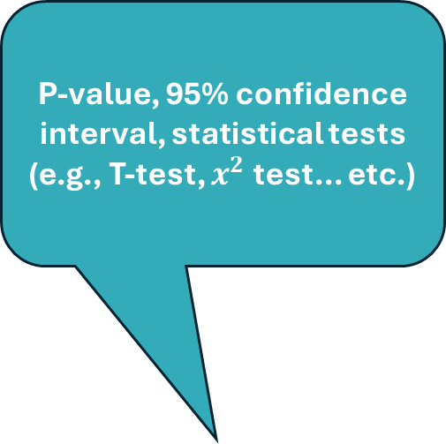
Population
Sample
Sampling
P-value, 95% confidence interval, statistical tests (e.g., T-test, $x^{2}$ test... etc.)
Inference
Inferential analysis
Notes:
التحليل الاستنباطي

Slide 11
2 | Motivating Examples

Slide 12
Motivating Example #1
Study [link]:
Assess the association between Calcium levels and:
  Severity of COVID-19 symptoms
  Multi-organ injuries (MOIs)
  Immune cytokines
Findings:
↓ Ca²⁺ levels in all COVID-19 cases
  Ca²⁺ in severe/critical < mild/moderate
↓ Ca²⁺ levels → ↑ MOIs
↓ Ca²⁺ levels → ↑ cytokines
Questions:
What are the types of data used?
What type of analysis is used?
What metrics are used?
How is the sample calculated?
What study design is used?

Slide 13
Motivating Example #1
Questions:
What are the types of data used?
What type of analysis is used?
What metrics are used?
How is the sample calculated?
What study design is used?
Baseline clinical characteristics:
  Age
  Duration (days from onset to admission
  Clinical classifications
Laboratory data:
  Serum electrolytes (Na, K, Cl, Ca)
  LFTs (AST, ALT, TBIL, DBIL)
  RFTs (BNP, BUN, creatinine, eGFR)
  Cytokine levels
COVID-19 diagnosis:
  Radiographic evidence of PNA
  +ve RT-PCR for SARS-CoV-2

Slide 14
Motivating Example #1
Questions:
What are the types of data used?
What type of analysis is used?
What metrics are used?
How is the sample calculated?
What study design is used?
Baseline clinical characteristics:
  Age
  Duration (days from onset to admission
  Clinical classifications
Laboratory data:
  Serum electrolytes (Na, K, Cl, Ca)
  LFTs (AST, ALT, TBIL, DBIL)
  RFTs (BNP, BUN, creatinine, eGFR)
  Cytokine levels
COVID-19 diagnosis:
  Radiographic evidence of PNA
  +ve RT-PCR for SARS-CoV-2

Slide 15
Motivating Example #1
Questions:
What are the types of data used?
What type of analysis is used?
What metrics are used?
How is the sample calculated?
What study design is used?
“data were expressed as Line at median and minimum–maximum were represented by the top/bottom of violin.”
D’Agostino and Pearson normality test
Shapiro–Wilk normality test
ANOVA
Mann–Whitney test (two-tailed)
Kruskal–Wallis test
χ² test
Fisher’s exact
“A P-value of less than 0.05 was considered to be statistically significant with a two-sided alternative.”

Slide 16
Motivating Example #1
Questions:
What are the types of data used?
What type of analysis is used?
What metrics are used?
How is the sample calculated?
What study design is used?
“We compared the calcium level regardless of the time of symptom onset, 80.9% severe/critical patients had calcium level below 2.2 mmol/l and it was lower than mild/moderate group (P<0.0001), and 41.0% of mild/moderate patients also showed calcium level under 2.2 mmol/l”
“We further analyzed the calcium change in different clinical severity groups after symptom onset: in the mild/moderate group, the calcium level of COVID-19 disease were significantly lower (P=0.0088) in the early stage (1–28 days) than later stage (after 28 days)”

Slide 17
Motivating Example #1
Questions:
What are the types of data used?
What type of analysis is used?
What metrics are used?
How is the sample calculated?
What study design is used?
“We compared the calcium level regardless of the time of symptom onset, 80.9% severe/critical patients had calcium level below 2.2 mmol/l and it was lower than mild/moderate group (P<0.0001), and 41.0% of mild/moderate patients also showed calcium level under 2.2 mmol/l”
“We further analyzed the calcium change in different clinical severity groups after symptom onset: in the mild/moderate group, the calcium level of COVID-19 disease were significantly lower (P=0.0088) in the early stage (1–28 days) than later stage (after 28 days)”

Slide 18
Motivating Example #1
Questions:
What are the types of data used?
What type of analysis is used?
What metrics are used?
How is the sample calculated?
What study design is used?
“From 29 January to 10 February 2020, 127 patients with confirmed COVID-19 admitted to Tongji Hospital were enrolled in this retrospective study.”

Slide 19
Motivating Example #1
Questions:
What are the types of data used?
What type of analysis is used?
What metrics are used?
How is the sample calculated?
What study design is used?
“From 29 January to 10 February 2020, 127 patients with confirmed COVID-19 admitted to Tongji Hospital were enrolled in this retrospective study.”

Slide 20
Motivating Example #2
Study [link]:
Assess the protective effects of community-wide bed net use
  i.e., estimate the association between proportion of a community using LLINs and malaria in children
Findings:
PORs
↑ 10% community bed net use →
  Rural: 1.13 (95% CI: 0.91, 1.41)
  Urban: 0.35 (95% CI: 0.13, 0.92)
Questions:
What are the types of data used?
What type of analysis is used?
What metrics are used?
How is the sample calculated?
What study design is used?

Slide 21
Motivating Example #2
Questions:
What are the types of data used?
What type of analysis is used?
What metrics are used?
How is the sample calculated?
What study design is used?
Bed net use
  Individual
  Community
Urbanicity
Age
Gender
Assets (electricity, mobile phone…)
Malaria parasitemia
  Diagnosed by RDT

Slide 22
Motivating Example #2
Questions:
What are the types of data used?
What type of analysis is used?
What metrics are used?
How is the sample calculated?
What study design is used?
“Descriptive statistics were used to characterize the study population, overall and within strata of individual bed net use.”
“we used multi-level logistic regression with a random intercept and two levels: individual and community.”

Slide 23
Motivating Example #2
Questions:
What are the types of data used?
What type of analysis is used?
What metrics are used?
How is the sample calculated?
What study design is used?
“To quantify the association between proportion of a community using LLINs and malaria in children with appropriate variance estimates, we used multi-level logistic regression with a random intercept and two levels: individual and community. We calculated the relative odds of malaria parasitemia within an individual due to a 1% or 10% change in community LLIN use and the relative odds of malaria parasitemia due to sleeping under a bed net compared with not sleeping under a bed net.”

Slide 24
Motivating Example #2
Questions:
What are the types of data used?
What type of analysis is used?
What metrics are used?
How is the sample calculated?
What study design is used?
“The data for this study come from the 2011 Liberia MIS, which is a cross-sectional population-based survey conducted by the Demographic and Health Surveys (DHSs) Program.”

Slide 25
Motivating Example #2
Questions:
What are the types of data used?
What type of analysis is used?
What metrics are used?
How is the sample calculated?
What study design is used?
“The analysis was cross-sectional to determine the association between malaria parasitemia and bed net use, both community and individual.”

Slide 26
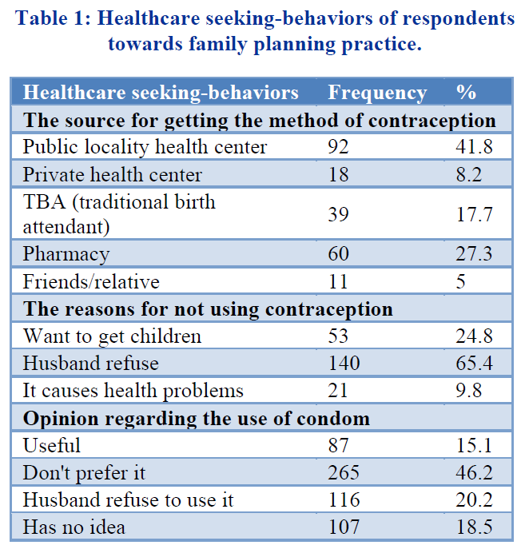
Motivating Example #3
Questions:
How many variables does this table include?
What are the types of data used?
What type of analysis is used?
What metrics are used?

Slide 27
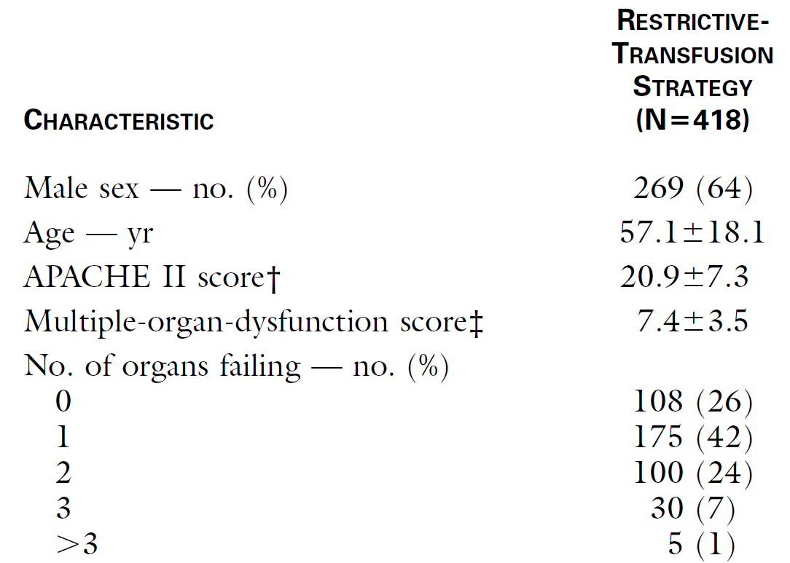
Motivating Example #4
Questions:
What are the types of data used?
What type of analysis is used?
What metrics are used?

Slide 28
3 | Exploratory Data Analysis

Slide 29
Comparative Analysis
Measures of Association
“Effect Size”
Bi-/Multivariate Analysis
Descriptive Analysis
Measures of Occurrence
Univariate Analysis
RR
OR
RD/AR
Regression
Uncertainty Estimates
Mean (SD)
Median (IQR)
Categorical Data
Numerical Data
Counts and proportions
Prevalence
Incidence
Numerical Data
Correlation
Linear Slope
$$y=a+bx$$
Regression
Correlation
Linear Slope
𝑦=𝑎+𝑏𝑥
Regression
Categorical Data
Linear Regression
X² Test
Logistic Regression
Categorical Data
Numerical Data
Numerical and Categorical Data
Compare group means or medians
Regression
Numerical and Categorical
T-Test
M/ANOVA
Wilcoxon
Regression
Exploratory Data Analysis (EDA)
Point Estimates
Inferential Analysis
Statistical Tests
Bi-/Multivariate Analysis

Slide 30
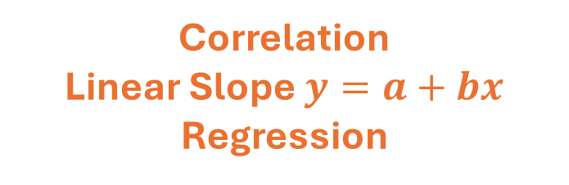
Measures of Association
Categorical
Numerical
RR
OR
RD/AR
Regression
Compare group means or medians
Regression
Categorical
Compare group means or medians
Regression
Correlation
Linear Slope $y=a+bx$
Regression
Numerical

Slide 31
Statistical Tests
Categorical
Numerical
T-Test
M/ANOVA
Wilcoxon
Regression
Categorical
X² Test
Logistic Regression
T-Test
M/ANOVA
Wilcoxon
Regression
Numerical
Linear Regression

Slide 32
4 | Visualizations for Exploratory Statistics

Slide 33
Bi-/Multivariate Data Visualization
Categorical
Numerical
Categorical
Cross-Tabulation
Boxplot
Scatterplot
Line chart
2 histograms
Numerical
Boxplot

Slide 34
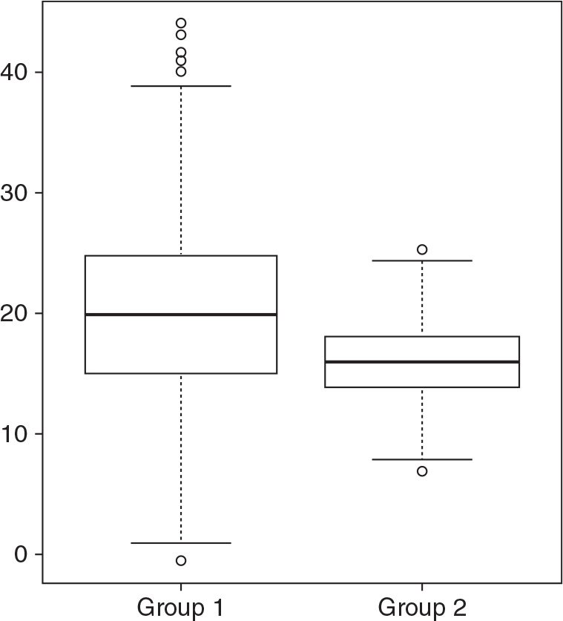
Boxplots

Slide 35
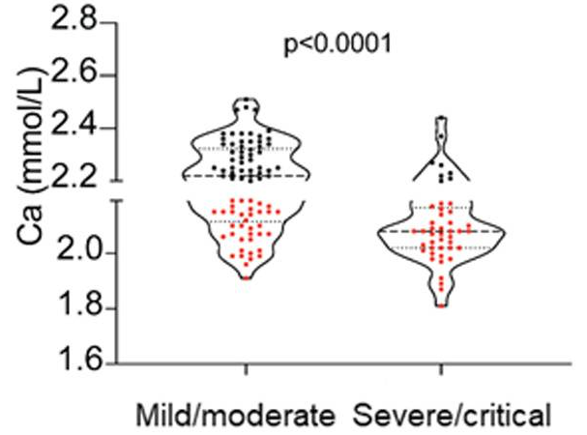
Violinplot—a Variant of Boxplot

Slide 36
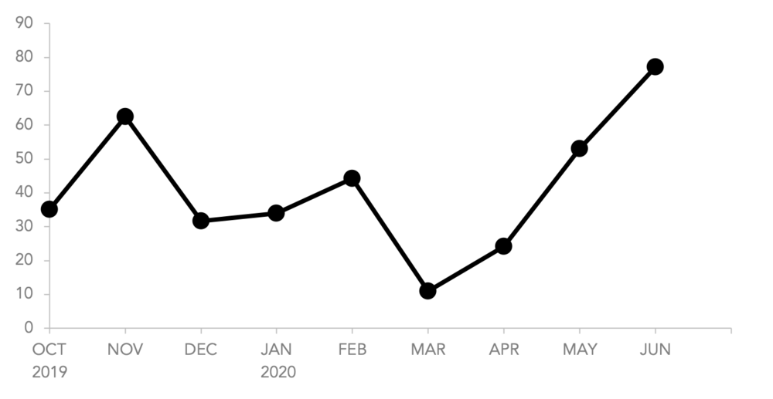
Line Chart

Slide 37
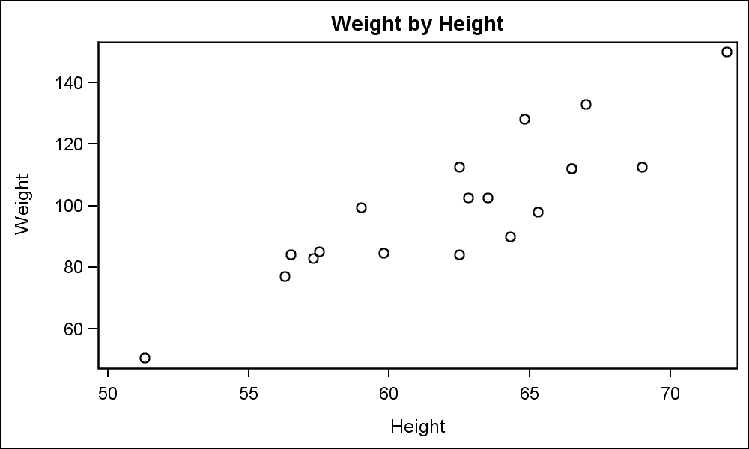
Scatterplot

Slide 38
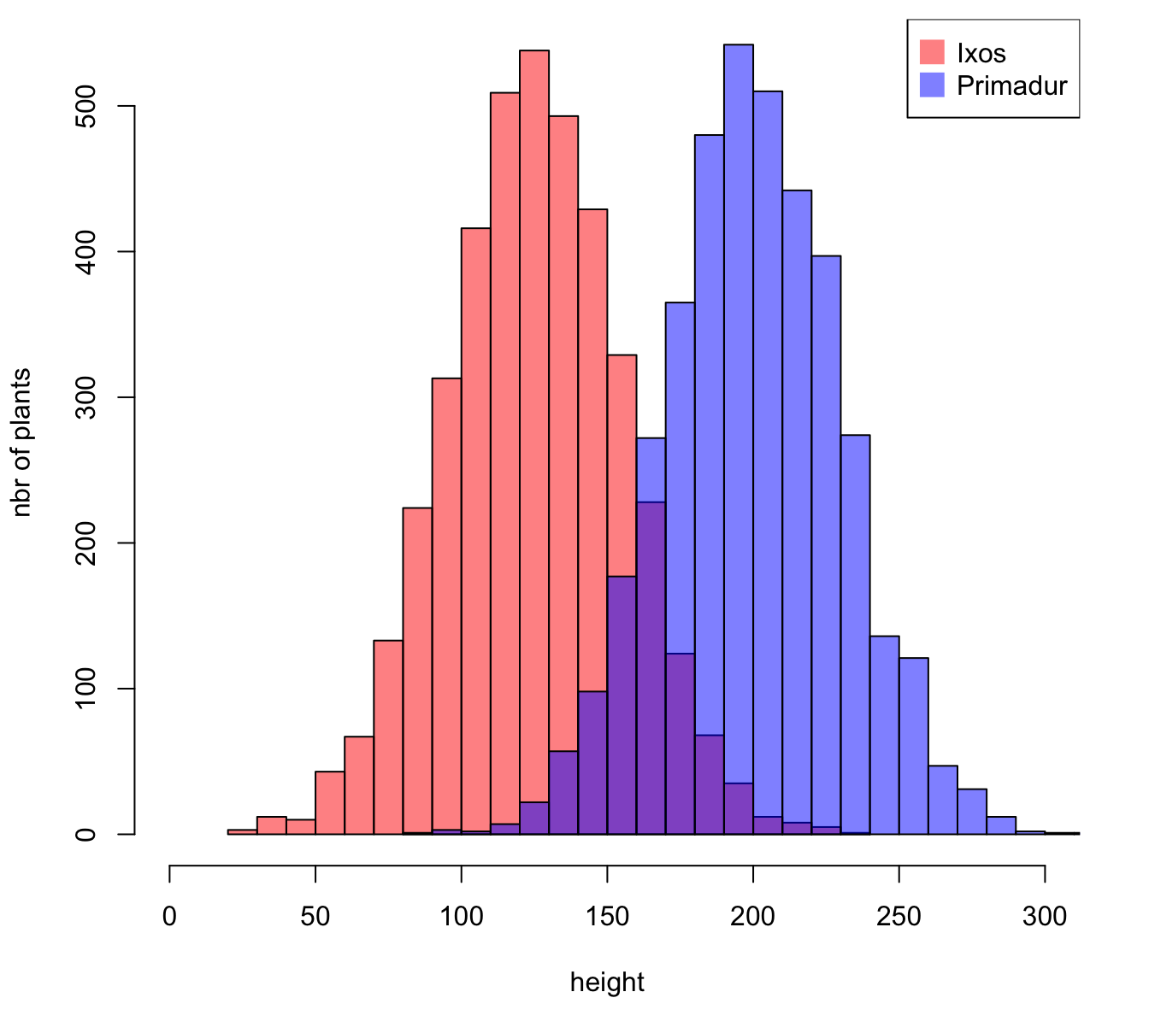
2 Histograms

Slide 39
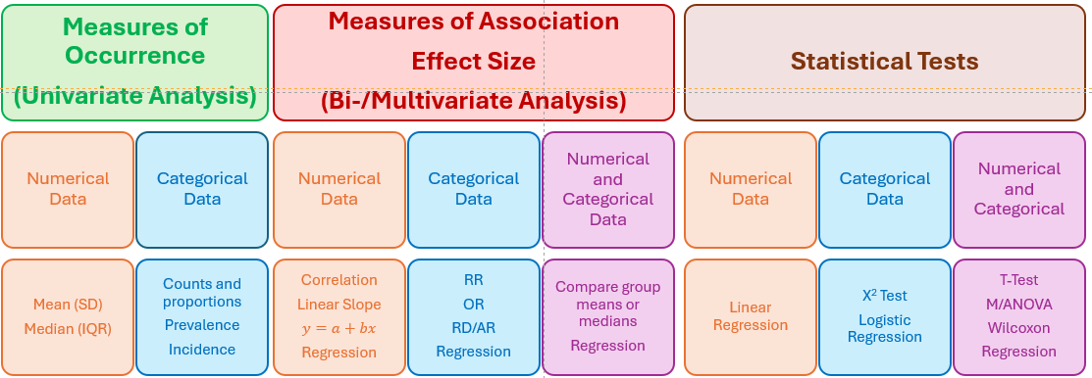
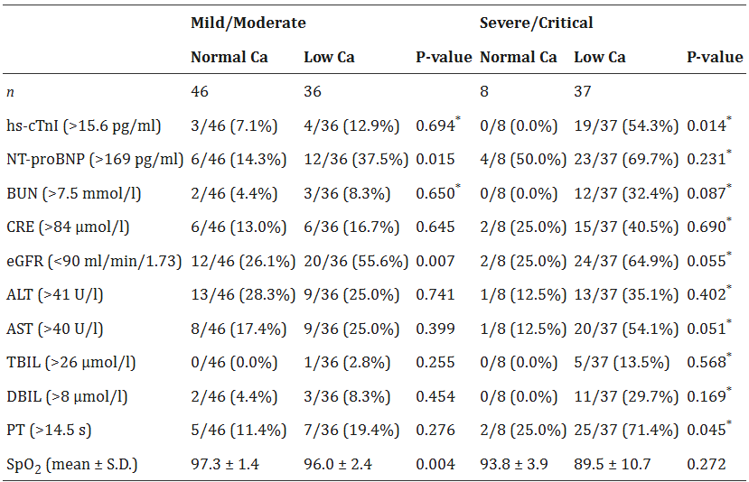
Cross-Tabulations

Slide 40
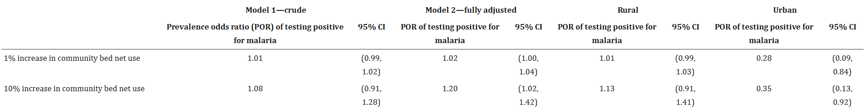
Cross-Tabulations

Slide 41
Next Session
Hypothesis Testing and Statistical Tests
Epidemiologic Study Designs
Communicating Evidence:
  Statistical Output Interpretation
  Visualization of Evidence

Slide 42


Thank you!
Email: mtalbirair@gmail.com
LinkedIn: https://www.linkedin.com/in/mohamed-albirair-0206bbb2/

